Slide 1
Pitching Injuries
By Nick Chapman

Slide 2

Introduction
Pitch F/x and MLB Statcast

Slide 3
Background
Pitcher Injuries costed an estimated 1.1 Billion dollars from 2008 -2012, according to a 2015 article from Forbes*.
This experiment is to test whether certain strategies lend themselves more to player safety as it relates to volume pitchers might see, the velocities they throw, and the proportions of their pitch types.
This data combines three sources:
Statcast: MLB Repository on gameplay statistics.
Tommy John Surgery List† by Jon Roegele.
MLB Disabled List (Spotrac)
† This is not a fully comprehensive list as the inclusion of the surgery in the list depends largely upon the reporting of the surgery… an indication some teams might be inclined to resist.
*https://www.forbes.com/sites/howardcole/2015/03/09/baseball-loses-1-1-billion-to-pitching-injuries-over-five-year-period/#3532c5622972

Slide 4
Hypotheses
Test whether there is a relationship between the percentage of off-speed pitches thrown, and injury next season.
Test for a relationship between a prior injury and injury next season.
Test whether there exists a relationship between decreased pitcher performance and injury next season.

Slide 5
Data Preparation
To conduct the experiment, I needed to clean the data in such a way that I got a thorough view of their last few years. I only included pitchers with at least 10 innings and at least 3 seasons.
Injury data was easily accessible for 2015-2019. Pitch f/x Pitching Data went back as far as 2013.
The 2018 season was used as a holdout.
Name | Team | Season | IP | IP_per_G
Stephen Strasburg | Nationals | 2019 | 209 | 6.333333
Gerrit Cole | Astros | 2019 | 212.1 | 6.427273
Trevor Bauer | - - - | 2019 | 213 | 6.264706
Shane Bieber | Indians | 2019 | 214.1 | 6.297059
Justin Verlander | Astros | 2019 | 223 | 6.558824

Slide 6
Model Formulation
Logistic Regression

Slide 7
Logistic Regression
The dependent variable, or whether the pitcher will get injured the following season, is a binary variable. I fit a logistic regression model, based on the Maximum Likelihood estimator, to these data. The final model is presented here:
formula = Injury_Next_Season ~ Pitches + Age + Prior Injury +
Pitches Per Inning+ IP_accel_2 + wSI..pi._accel_2 + wFA..pi._accel_2 +
walk_rate + win_rec + vFA..pi. + FA...pi. + tj + FA.Z..pi. +
wild_pitch_rate_accel_2 + vFA..pi.:FA...pi. + IP_accel_2:FA...pi. +
P_per_IP:IP_accel_2 + FA...pi.:FA.Z..pi. + P_per_IP:wFA..pi._accel_2 +
wSI..pi._accel_2:wFA..pi._accel_2 + tj:wild_pitch_rate_accel_2
Note: Logistic Regression requires that observations are independent, but does not require the explanatory variables to be linearly related to the dependent variable. Similarly, there is no assumption of constant variance or of normality in the errors.

Slide 8
Variable Selection
Reducing multicollinearity and NOISE

Slide 9
Multicollinearity
 | Pitches | IP | Accel in innings (2 years) | Accel in pitches (2 years) | FA % | Sinkers & Cutters %
Pitches | 1.00
IP | 0.99 | 1.00
Accel in innings (2 years) % | 0.41 | 0.42 | 1.00
Accel in pitches (2 years) % | 0.42 | 0.42 | 0.99 | 1.00
FA % | -0.08 | -0.10 | 0.04 | 0.04 | 1.00
Sinkers & Cutters % | 0.04 | 0.07 | -0.02 | -0.02 | -0.85 | 1.00
There were some variables that required dropping prior to training:
Since Pitches and IP are essentially providing the same information. I opted to included just IP.
Same scenario with IP and Pitches Acceleration. I kept it consistent with IP.
Finally, the proportion of fastballs pitched is inversely related to the proportion of Sinkers and Cutters pitched. I kept Fastballs in for this analysis.

Slide 10
Variable Creation
Variable Creation
Interaction Terms
Created a pool of variables based on games, pitches, innings associated with pitch types.
In order to get a sense of acceleration or deceleration in pitch types or volumes over the recent past, I took the current value minus the mean lagged 2 years.
After removing correlated variables, I explored possible combinations of interactions in the stepwise regression.
Among the notables included were:
Fastball Velocity * Fastball Percentage
Sinker_Efficacy_Accel * Fastball_Efficacy_Accel
P_Per_IP * IP_Accel_2

Slide 11
Forward Selection
AIC
Likelihood Ratio Test
Using AIC as the criterion for accepting new variables into the model, I tested each of my generated variables to test their significance in the model.
AIC penalizes models with poor fit and more parameters.
Using LRT as the criterion for accepting new variables into the model, I performed Forward Selection with the Step function in R.
LRT will test whether there is a statistical difference between the current model and the proposed model with new variable k.
Finally, I went with the model chosen by the AIC forward selection, which resulted in the best performance on the holdout sample.

Slide 12
Model Diagnostics
AUC and Recall

Slide 13
Area Under The Curve
With an unbalanced dataset, accuracy doesn’t give the whole picture. With an injury rate of 30%, a prediction of no injury would result in an otherwise impressive 70% accuracy, better than random guessing already.
AUC can be a good measure of how well the model can distinguish between the classes, rather than how often it is correct overall. The final model achieved an AUC score of .631 on the training data, a moderately successful result.

Slide 14
Recall Rate (Final Model)
Training
At P > .3 | Predicted Not Injured | Predicted Injured
Not Injured | 685 | 407
Injured | 173 | 287
At a 30% probability rate, the model captures 124 out of 197 injuries. A recall rate of 62.9%.
Conversely, the model predicted 210 pitchers would get injured the following season when they didn’t, generating a false positive rate of 42.5%
Test (Holdout)
At P > .3 | Predicted Not Injured | Predicted Injured
Not Injured | 284 | 202
Injured | 73 | 118

Slide 15
Outlier Detection

Slide 16
Influential Statistics
Season | Injury | Player | Leverage | Cook’s D | DF Fits | DF Betas
2015 | 0 | ADAM WAINWRIGHT | 1 | 0 | 1 | 0
2015 | 0 | PETER MOYLAN | 1 | 0 | 1 | 0
2016 | 0 | BRUCE RONDON | 1 | 0 | 1 | 0
2016 | 1 | JOE BLANTON | 1 | 0 | 1 | 0
2016 | 0 | ALEX CLAUDIO | 1 | 0 | 1 | 0
2.27% Of Observations flagged as influential statistics.
Of these high influence points, 62.8% of them were positive for injuries in the next season.
Because this is an imbalanced dataset, I didn’t want to remove these statistics. I used them to make sure there were no errors in the variable creation stage.
The top 5 player-season combinations that flagged for two out of four outlier statistics are shown.
I need to do more research on outlier identification in logistic regression.

Slide 17
Model Inference

Slide 18
Coefficients Testing Hypotheses
Coefficient | Estimate | Z-Value | P-value | Odds Ratio
Fastball Percentage | -15.84 | -2.710 | 0.006720 | 0.854
Prior Injury | 0.6303 | 4.404 | 1.06e-05 | 1.887
Pitcher Performance | 0.01664 | 2.642 | 0.008240 | 1.016
The final model had an AIC of 1813 with 22 variables, 18 of them significant. 7 Indicator variables.
.613 AUC; 59% accuracy; 42.5% False Positive Rate; The model is doing an ok job separating injured and non-injured players.

Slide 19
Results (Hypothesis)
Hypothesis I: Test whether there is a relationship between the percentage of off-speed pitches thrown, and rate of injury.
With a p-value of .00590, we reject the null hypothesis that there is no relationship between percentage of off speed pitches thrown and rate of injury.
For a 1 percent increase in Fastball Percentage, there is an associated decrease in the probability of injury next season by 15%, while holding all other variables constant.
Hypothesis 2: Test for a relationship between a prior injury and injury next season.
With a p-value of 9.81e-06, we reject the null hypothesis that there is no relationship between an existing injury and the likelihood of injuries the next season.
The odds of injury in the next season for players with pre-existing injuries are 88% greater than for players with no pre-existing injury.
Hypothesis 3: Test whether there exists a relationship between decreased efficacy and injury next season.
With a p-value of 0.008240, we reject the null hypothesis that there is no relationship between decreased pitcher performance and injury next season.
‘
For a 1 unit increase over a three year period for runs against the slider pitch multiplied by the runs against the fastball pitch, there is an associated increase in the probability of injury next season by .016%, while holding all other variables constant. For example, if the allowed runs by the pitcher for the slider pitch and the fastball pitch increase by 1 for the last three years, the probability of injury increases by .016%

Slide 20
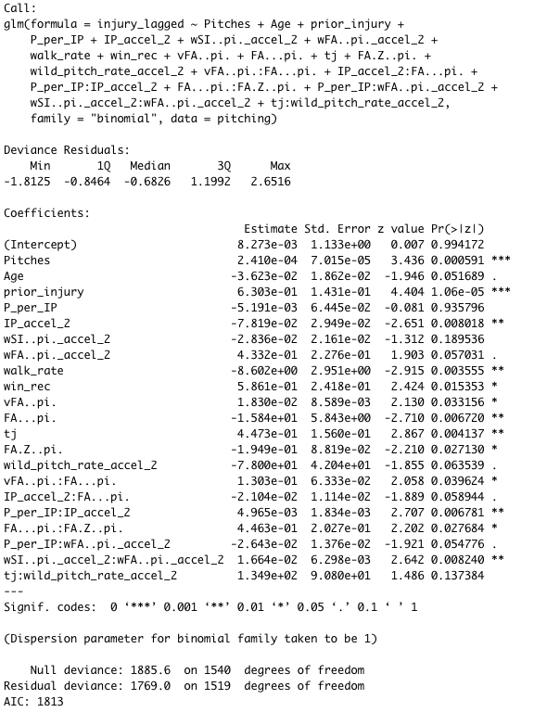

Slide 21
Conclusions & Limitations

Slide 22
Conclusions
Model Efficacy
Future Study
Overall the model does an ok job predicting the injured class. The False Positive Rate is high on the non-injured class.
Though I removed collinearity from the initial variable pool, there still be multicollinearity lurking and skewing my coefficients.
A pitcher’s tendency toward injury deserves a broader analysis.
Studies of young athletes over a long period of time that are then subject to MLB conditions might serve as a better data source.
Pitching technique is often discussed in this space. Could Deep Learning work here?

Slide 23
Predictions (Holdout)
Predicting Injuries for 2020 Season*
In 2020, the model predicted that out of 602 Pitchers that recorded at least 10 Innings in 2019, 226 would get injured at some point in the 2020 season.
*Assuming there is a 2020 season

Slide 24
The End

